Slide 1
PLC Programming: What are Programming Paradigm?
Understanding the Foundations of Programming
Presented by: Manuel Ramos

Slide 2
Introduction
What is a Programming Paradigm?
Definition: A programming paradigm is a fundamental style or approach to programming that influences how software is designed, structured, and written. It dictates the way developers think about and solve problems in code.

Slide 3
Introduction
Key Components of Programming Paradigms:
Conceptual Framework:
Paradigms provide a framework for understanding how to approach programming tasks. They establish the principles and methodologies that guide code development.
Programming Style:
Each paradigm offers a unique style of writing code
Structured Programming emphasizes a clear, linear flow of control through the use of functions, conditionals, and loops. This approach promotes the organization of code into reusable modules, making programs easier to understand and maintain.
Design Patterns:
Paradigms often come with established design patterns that help programmers solve common problems efficiently.
Structured Programming emphasizes control structures (like loops and conditionals) to manage flow and promote clearer code organization. Patterns such as top-down design and modular programming are key strategies in this paradigm.

Slide 4
Introduction
Why Are Programming Paradigms Important?:
Diverse Problem-Solving Approaches:
Different paradigms equip developers with varied tools and techniques. Understanding multiple paradigms allows for more flexible and effective problem-solving.
Language Features:
Many programming languages are designed with specific paradigms in mind. Knowing the paradigms helps in choosing the right language for a task and using its features effectively.
Code Readability and Maintenance:
Paradigms influence code organization, which impacts readability and maintainability. For example, structured programming promotes a clear, logical flow that makes it easier to understand and maintain code.
Career Development:
Familiarity with multiple paradigms enhances a developer's skill set, making them more adaptable in various programming environments and increasing their marketability.

Slide 5
Why Learn Programming Paradigms?
Understanding why programming paradigms matter is crucial for both new and experienced developers. Each paradigm provides a different perspective on how to approach problem-solving and software design, which is key to becoming a versatile and effective programmer.

Slide 6
Why Learn Programming Paradigms?
Diverse Problem-Solving Approaches:
Different Thinking Styles:
Each paradigm encourages you to think about problems in a unique way.
Adaptability to Problem Types:
Some problems are best solved using a particular paradigm
Improved Code Efficiency and Quality
Efficient Problem-Solving:
Paradigms provide structure and techniques that lead to cleaner, more efficient code.
Reusability and Scalability:
Paradigms like OOP emphasize code reuse through inheritance and encapsulation, helping you create modular, reusable, and scalable systems.

Slide 7
Why Learn Programming Paradigms?
Versatility in Using Multiple Languages:
Language Independence:
Each paradigm encourages you to think about problems in a unique way.
Example:
Structured Text (ST)
declarative programming paradigm
Functional Programming
Structure Programming
Sequential Function Charts (SFC)
imperative programming paradigm
Ladder Logic Diagram (LD)
imperative programming paradigm
Structure Programming
Function Block Diagram (FBD)
imperative programming
Instruction List (IL)
imperative programming
By understanding the underlying paradigms, you can easily transition between programming languages.

Slide 8
Why Learn Programming Paradigms?
Enhanced Problem-Solving Abilities:
Choosing the Right Approach: Each paradigm is optimized for solving certain types of problems. Knowing the differences helps you make informed decisions about which paradigm to use:
Imperative Programming is ideal for performance-critical applications where you need control over system
Functional Programming shines in situations where data immutability and parallelism are critical, such as data processing and analytics.

Slide 9
Why Learn Programming Paradigms?
Collaboration and Teamwork:
Shared Understanding: When working in a team, having a shared understanding of the chosen programming paradigm helps ensure consistency across the codebase. Teams often adopt a paradigm based on the nature of the project
Communication: Understanding paradigms provides a common vocabulary for discussing code design and problem-solving approaches.

Slide 10
Conclusion
Understanding programming paradigms gives you more tools in your developer toolbox. It allows you to:
Write better, more efficient, and maintainable code.
Approach problems from different angles.
Collaborate more effectively with other developers.
Stay versatile and adaptable to new technologies.

Slide 11
PLC Programming
Problems with writing PLC Code for Large program
Cumbersome
Time-Consuming and difficult to develop, debug and maintain
Slow down the scan time
Hard to follow for others

Slide 12
PLC Programming
Solving the problem with writing big programs
Use programming paradigm
Structured programming is a programming paradigm aimed at improving the clarity, quality, and development time of a computer program by making extensive use of the structured control flow constructs of selection (if/then/else) and repetition (while and for), block structures, and subroutines in contrast to using simple tests and jumps such as the go to statement, which can lead to “spaghetti code” that is potentially difficult to follow and maintain.
https://press.rebus.community/programmingfundamentals/chapter/structured-programming/
Develop a framework
Descries a set of solutions and processes to aid in the development of software
Benefits
Saves time
Ensure best practices are followed

Slide 13
PLC Programming
Control Structures
The mechanisms that allow us to control the flow of execution are called .
Sequence
Do one instruction then the next and the next.
Just do them in a given sequence or in the order listed
Selection
Choose between two or more flows.
Iteration, Repetition or Looping
Allows code to be executed several times until some condition has been met
https://press.rebus.community/programmingfundamentals/chapter/structured-programming/

Slide 14
PLC Programming
Defining a Control Structure
That can run a sequence in a controlled fashion
Numerically Sequenced
To easily follow the path of execution
Can be skipped to improve cycle time
Use jump and label in a limit fashion
Stage and End Stage command
Controlled by an enable flag (bit)
Enter or start the Control Structure
Start process flag
Exit or stop the Control Structure
Stop process flag
Stop and cleans up the Control Structure process

Slide 15
PLC Programming
Each PLC provides a different way of accessing bits
So it up to the individual programmer to develop the control structure to meet the hardware constraints.
The following slide will show 3 different implementation used in various PLC

Slide 16
PLC Programming
Defining a Control Structure for Omron CX-Programmer

Slide 17
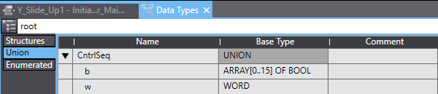
PLC Programming
Defining a Control Structure for Omron SYSMAC
In the SYSMAC environment
The use of Union was the best way I found to access the BITS in a WORD
Since a Union is a set of variables with same offset therefore occupies the same memory space.
Hence, b is array of 16 Boolean that can directly access the bits in the WORD.

Slide 18
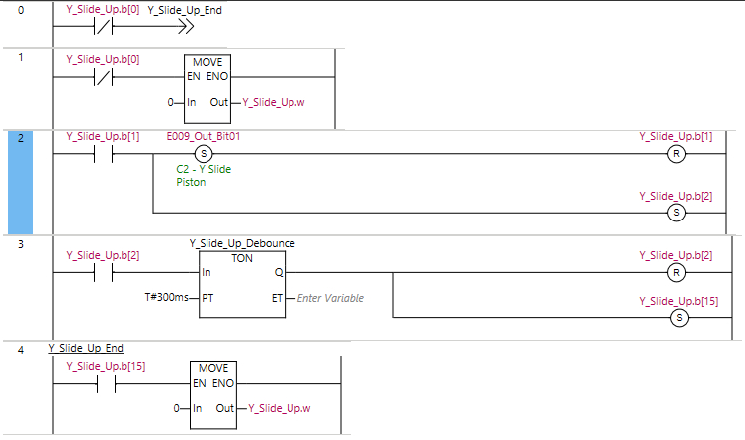
PLC Programming
Defining a Control Structure for Omron SYSMAC
In the SYSMAC environment
This the basic control structure that was developed.
Y_Slide_Up variable is defined by Union definition in the previous screen call CntrlSeq
Bit 0 is the enabling bit
If the Bit 0 is off, jump statement is enable and takes the execution of PLC code to the end of the control structure
Bit 1 is the Starting bit
Y_Slide_Up.b(1) rung sets an output variable “E009_Out_Bit01” then proceed to reset the current rung Y_Slide_Up.b(1) then set the next rung Y_Slide_Up.b(2) .
Y_Slide_Up.b(2) Rung enables a Timer On function block defined by time variable T#300ms.

Slide 19
PLC Programming
Defining a Control Structure for Omron SYSMAC
bit
In the SYSMAC environment
Y_Slide_Up.b(2) Rung enables a Timer On function block defined by time variable T#300ms.
Once the timer complete Y_Slide_Up.b(2) is reset and Y_Slide_Up.b(15) is set.
Y_Slide_Up.b(15) is the stop flag which activate the MOVE function that copy 0 to WORD portion that resets all of the bit in the CntrlSeq variable.

Slide 20
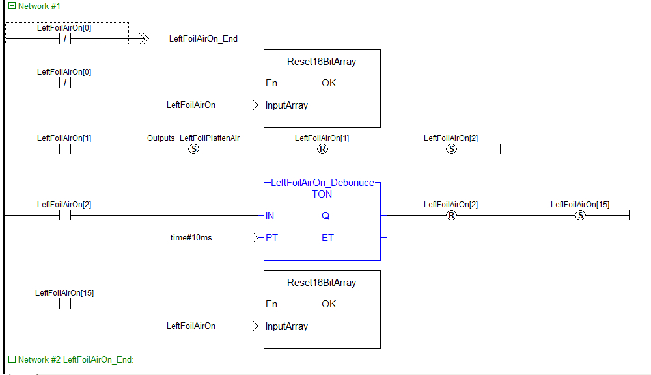
PLC Programming
Defining a Control Structure for Kollmorgen Automation Suite
LeftFoilOn[x] is an array of 16 bool
LeftFoilOn[0] is the Enabling bit
If LeftFoilOn[0] is Off the
-->> LeftFoilAitOn_End is the Jump Statement that bypasses this Network of code.
On Network #2: LeftFoilAirOn_End is the label that the Jump statement refers to.
The Reset16BitArray function block is used to reset the individual bits in the array
LeftFoilOn[1] is the starting bit for the block of code
LeftFoilOn[1] rung sets an output variable “Outputs_LeftFoilPlattenAir” then proceed to reset the current rung LeftFoilOn[1] then set the next rung LeftFoilOn[2].

Slide 21
PLC Programming
Defining a Control Structure for Kollmorgen Automation Suite : Continued
LeftFoilAirOn[2] Rung enables a Timer On function block defined by literal time variable time#10ms.
After 10ms the LeftFoilAirOn[2] rung is Reset and the Last Bit in the array is set to finish the block.
LeftFoilAirOn[15] activates the Reset16BitArray function block which reset the array of bits in the LeftFoilAirOn array thereby turning off the block of code.
This block code represents the basic building block of ladder logic that will be used to write your programs.

Slide 22
PLC Programming
Defining a Control Structure for Kollmorgen Automation Suite : Continued
LeftFoilAirOn[2] Rung enables a Timer On function block defined by literal time variable time#10ms.
After 10ms the LeftFoilAirOn[2] rung is Reset and the Last Bit in the array is set to finish the block.
LeftFoilAirOn[15] activates the Reset16BitArray function block which reset the array of bits in the LeftFoilAirOn array thereby turning off the block of code.
This block code represents the basic building block of ladder logic that will be used to write your programs.

